Slide 1

Predicting Customer Buying Behaviour

Slide 2
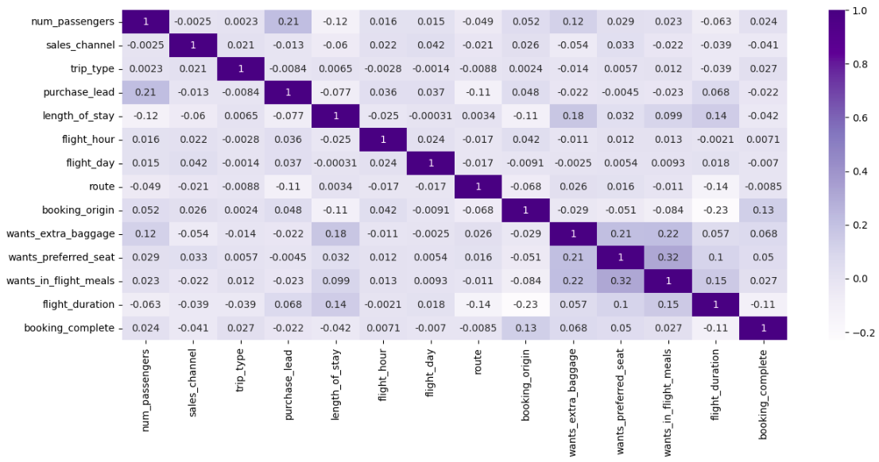
Insights from the dataset
Correlation Matrix of all the features
Here are the scores after applying different models to the dataset
Logistic Regression: - Accuracy: 0.8517 - AUC Score: 0.499
Random Forest: - Accuracy: 0.8511 - AUC Score: 0.550
XGBoost - Accuracy: 0.8506 - AUC Score: 0.543
SVC: - Accuracy: 0.8378 - AUC Score: 0.510
ANN: - Accuracy: 0.8521 - AUC Score: 0.501
Conclusion: AUC Score must be improved
We can see that route, booking_origin and flight_duration influence the customer’s buying behaviour the most, due to low correlation values

